Slide 1
Interchange Design
Nick Hoernke, Bill Roth and Eric Sorensen

Slide 2
Presentation Overview
Interchange Characteristics
Process for Interchange Type Selection
Service Interchange
System Interchange
New Type of Interchange
Design Process and Details
Interchange Attributes to Consider

Slide 3
Interchange Characteristics
Two main types of interchanges
Service Interchange – between a freeway or controlled access facility and a lower class roadway such as an arterial or collector (i.e. diamond)
System Interchange – between two or more freeways or controlled access facilities (i.e. cloverleaf)

Slide 4
Interchange Characteristics
Attributes of interchange type varies
Traffic Operations
Safety
Physical Impacts (R/W)
Construction Cost
Constructability

Slide 5
Process for Interchange Type Selection
Process for Interchange type selection
Data Collection
Planning Framework
Identify and develop Concepts
Evaluate and Screen Alternatives
Select Preferred Alternative

Slide 6
Process for Interchange Type Selection
Additional items to consider
Identify and understand key project issues
Design creativity and context sensitivity
required to develop feasible solutions
Maintain fiscal feasibility
Maintain/enhance local access in reconstructing urban system ramp interchanges
Incorporating exclusive HOV lanes or ramps
Complicates the design and increases cost
Constructability
Reconstruction typically requires maintaining all movements

Slide 7
Service Interchange
Urban and Suburban Areas (tight R/W constraints)
Single Point Design creativity and context sensitivity
One intersection vs. two along local roadway
Expensive
Compressed or Tight Diamond
Intersections spaced 250’-400’ apart
Similar footprint to SPDI
Operational Characteristics
Determine number of lanes
Traffic operations are key to success

Slide 8
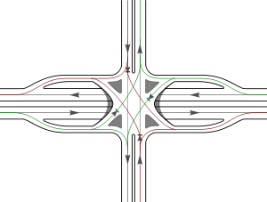
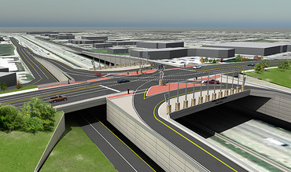
Service Interchange
Single Point Diamond Interchange (SPDI)

Slide 9
Service Interchange
Urban and Suburban Areas (tight R/W constraints)
Single Point Design creativity and context sensitivity
One intersection vs. two along local roadway
Expensive
Compressed or Tight Diamond
Intersections spaced 250’-400’ apart
Similar footprint to SPDI
Operational Characteristics
Determine number of lanes
Traffic operations are key to success

Slide 10
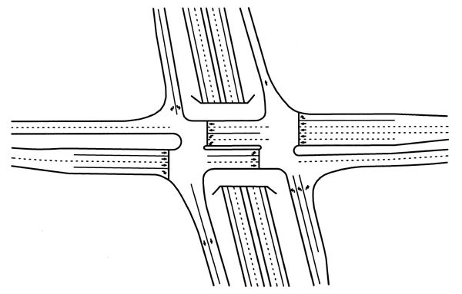
Service Interchange
Compressed or Tight Diamond Interchange

Slide 11
Service Interchange
Urban and Suburban Areas (tight R/W constraints)
Implement selection process
12 points for the design of system interchanges
Maintain route continuity
Maintain basic number of lanes
Provide lane balance and continuity
Maintain appropriate ramp spacing
Design ramps for freeway speeds
Select appropriate interchange types
Employ only right-hand entrances and exits
Provide single exit at interchanges
Provide exits in advance of crossroad
Provide decision sight distance in advance of exits
Eliminate weaving within interchanges along the mainline
Provide designs that can be simply signed

Slide 12
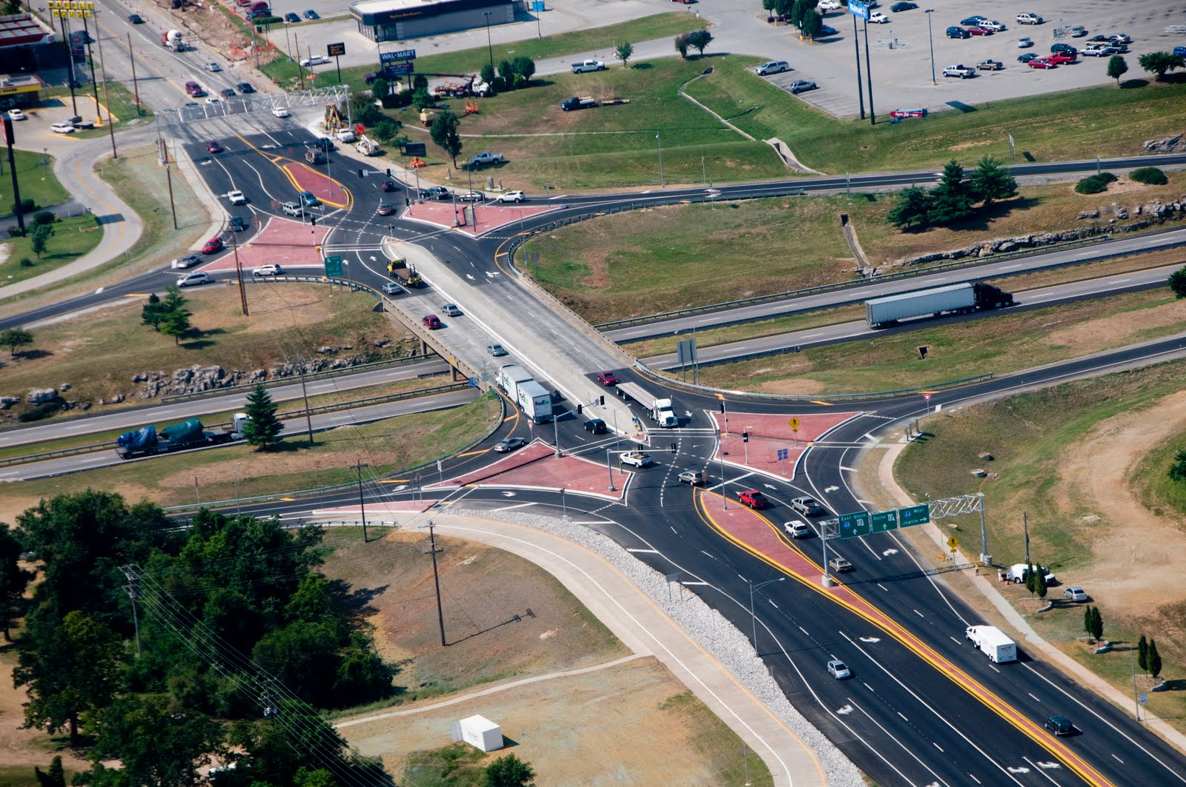
New Type of Interchange
Diverging Diamond

Slide 13
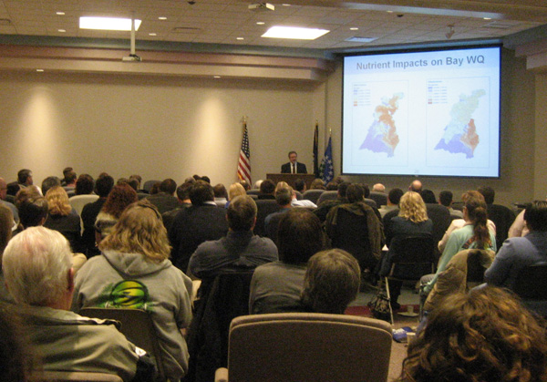
Design Process and Details
Stakeholders
Maintaining Authority
Traveling Public
Impacted Public
Landowners
Environment
Politics
Federal Funding
Be Honest!

Slide 14
Design Process and Details
Geometrics
Iterative process
Provide desirables
DSD, SSD, etc…
Avoid flat spots and crown transitions
Rollovers
Nearby interchanges
Lane Balance
Barrier Concept
Adequate Signing
Structures - Construction restrictions to traffic

Slide 15
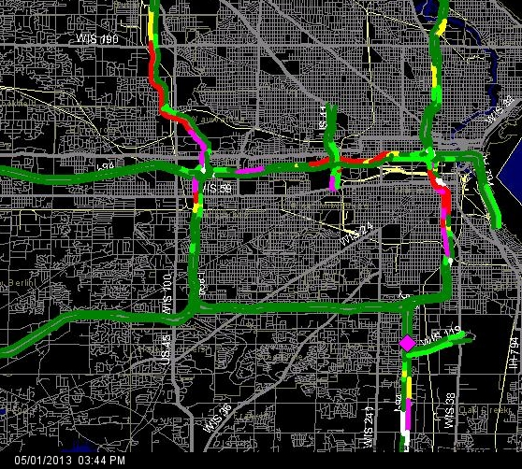
Design Process and Details
Traffic
Large trucks
Avoid off-ramp queueing onto freeway
Analysis for staging and permanent conditions.
Milwaukee area – Congestion map

Slide 16
Design Process and Details
Staging
Finding the optimal balance
Impacts of staging
Tie-ins & project length, ROW, Utilities
Justify expenditure to provide desirable features
Over the top first
Traffic considerations
Seasonal peaks
Concurrent projects along corridor

Slide 17
Design Process and Details
Staging continued…
Structures
Lateral and vertical clearance
Construction joints
Future fill/cut at footings
Settlement of embankments
Design drainage for winter maintenance
Early project to eliminate complications
Lessons learned

Slide 18
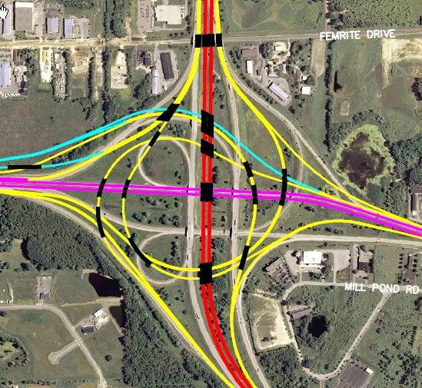
Interchange Attributes to Consider
Design
Type, Size:
Single point, trumpet, three leg, one quadrant, diamond, cloverleaf, etc…
Based on typically 6 warrants
Determine # lanes, heavy movements, crash locations.

Slide 19
Interchange Attributes to Consider
Design Continued…
Utilities
Existing? Proposed?
Space or R/W constraints
Real Estate
Safety, Safety, Safety
AASHTO Green Book, FDM, AASHTO RDG, MUTCD. How do these affect the design?

Slide 20
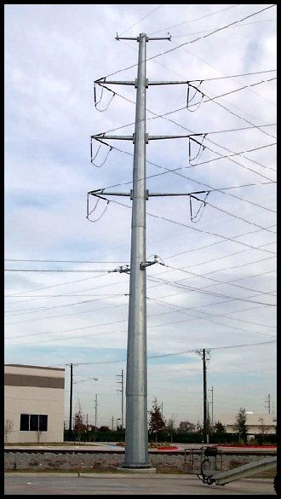
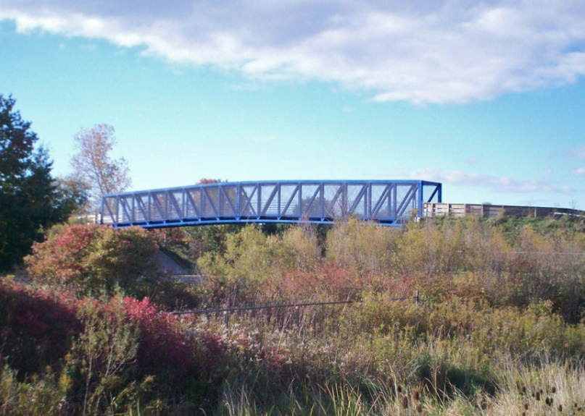
Interchange Attributes to Consider
Users
Local Facilities
Economics
Travel Times
Utilities - NIMBY
Multi-modal
Environmental/Recreation

Slide 21
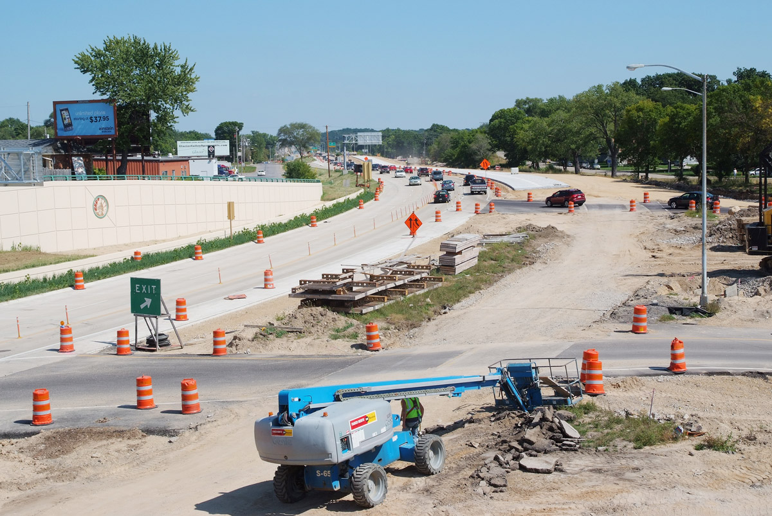
Future Considerations
Future Considerations
Additional Lanes / Interchange capacity
Future development in the immediate area
Overhead utilities and constructability of structures
OSHA requirement for cranes
Address in utility coordination
Temporary traffic shifts for maintenance and rehab
Leave in crossovers used for construction
Wider, “beefed up” shoulders necessary?

Slide 22
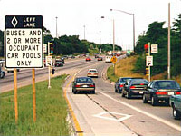
Future Considerations
Future Considerations Continued…
Profile gradient should be steep enough to accommodate future barrier wall when highway expanded.
Ramp Metering
Ramp spacing between terminals
Congestion
Queue spillback
Stop and Go travels
Heavy weaving
Poor traffic signal progression

Slide 23
Questions????

